Slide 1

Library Management System
By:
Khushi Mattu 20BCE1189
Nithish Kanna 20BCE1304
Uditi Gupta 20BCE1445

Slide 2
Problem Statement
A library stores numerous books and has many members who are interested in reading those books. And maintaining such magnitude of books and members requires modern technologies.
Library management system is to provide an easy system to issue a book from the library if it is available or he/she can even use e-book. It also keeps track of the issued books and their due dates along with fine generation if required.
It is basically for easy management by the librarian or the administration and for students to not waste their time in searching a particular book in the library.
We aim to accomplish this by creating a website that can be accessed by the admin and the library members if they want to issue a book by the end of this semester i.e. December.

Slide 3
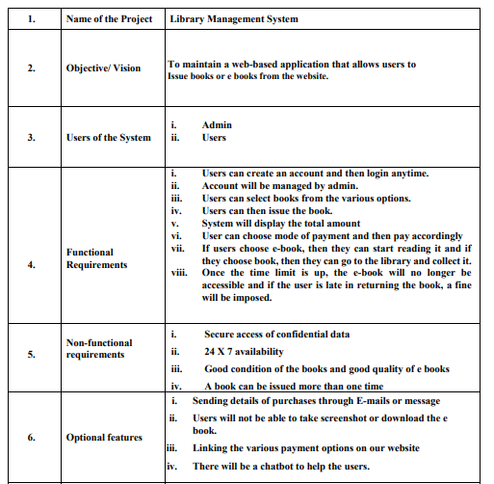
Scenario

Slide 4
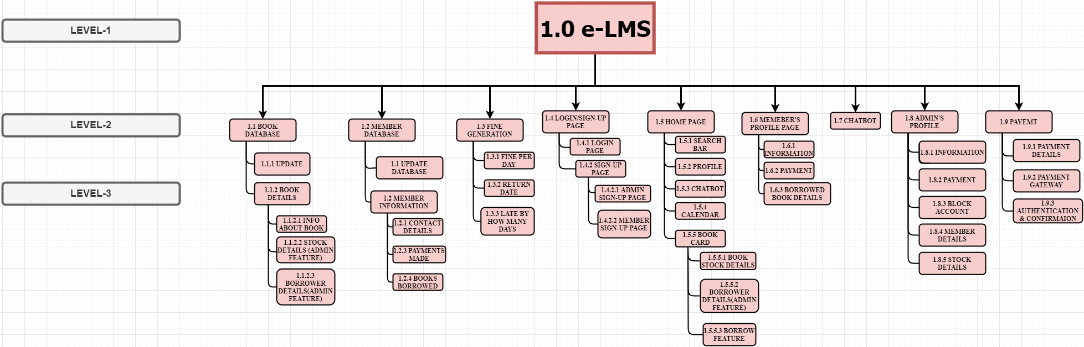
WBS Diagram

Slide 5
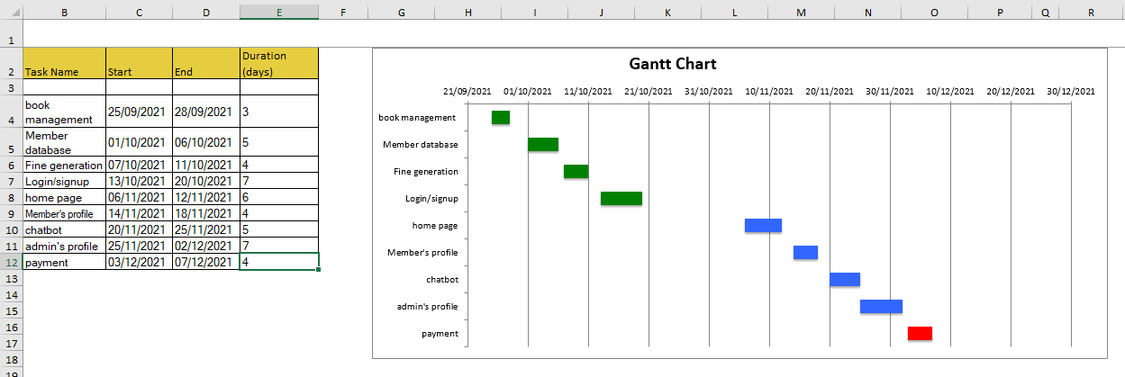
Gantt Chart

Slide 6


